Slide 1

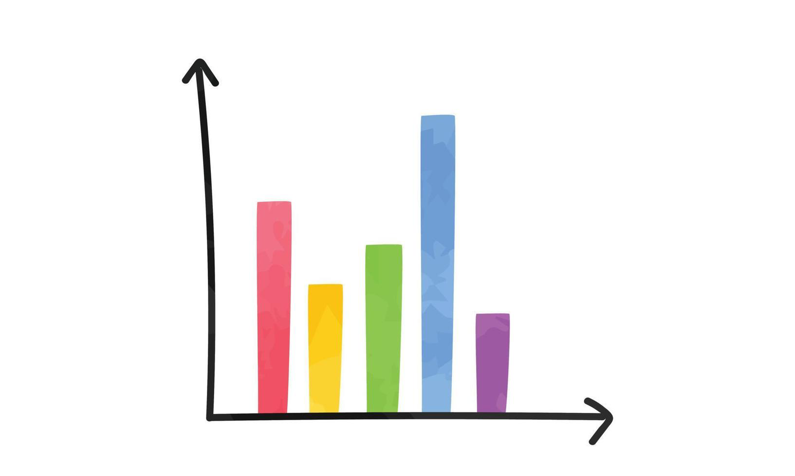



Welcome back to P4!
This term in Primary 4 we will be learning…
In Numeracy we have been learning about patterns and relationships involving shapes and numbers. We will be moving onto expressions and equations, where we will learn about different symbols used to compare numbers, as well as using a range of strategies to solve simple equations. We will also use the last term to revise everything we have covered this year, including the four operations.
Our first maths ‘topic’ this term is data analysis. We will be learning about how to collect, display and analyse data using different types of graphs. Miss Dorrell will be teaching us about measure this term. We will look at measuring length, mass and capacity.
Literacy
Maths & Numeracy
Reading
Last term, we really enjoyed reading ‘The Wild Robot’ as our class novel! This term, we have started the next book in the series: ‘The Wild Robot Escapes.’ Every day, we work on our reading skills by answering questions, summarising, predicting, making inferences and more. We are also continuing to practise reading with fluency in our individual reading groups. Children get the chance to read aloud independently, in small groups and 1:1 with an adult every week.
Spelling
We will continue to explore
different sounds and
spelling patterns with our
weekly spelling words,
which will be incorporated
into our home learning tasks.
Health & Wellbeing
Social Studies –
Sustainability
Building Resilience
Throughout this term, a focus of our Health and Wellbeing, aside from P.E. and Outdoor Learning, will be our Building Resilience program. This term, our focus is ‘Keep Connected’. This will be covered both in class and in assembly.
Primary 4 have decided to do a sustainability topic this term. We will be learning about the causes of climate change and how these affect the plant in different ways. We will research things we can do as individuals and as a school to help the planet.
Part of our Health & Wellbeing learning this term is healthy eating. This will link well with our topic as we will explore how food is produced in sustainable ways.
Zones of Regulation
This term, we are learning to recognise and manage how we are feeling using the Zones of Regulation. Children will learn about the four zones and how to identify which zone they are in. They will practise using strategies to get back into the ‘green zone’. Click the link below for more information:
https://great-rollright.oxon.sch.uk/wp-content/uploads/2022/11/Zones-of-Regulation-Parents-Handout.pdf

Slide 2
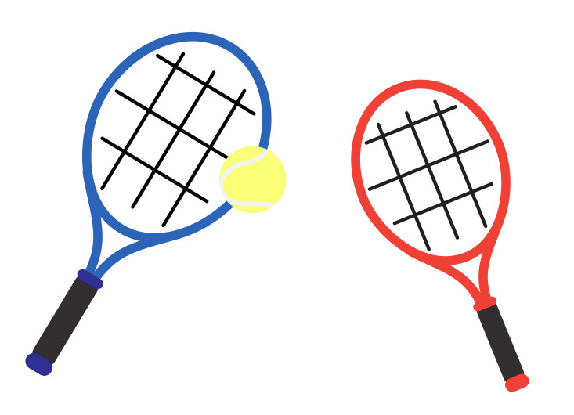
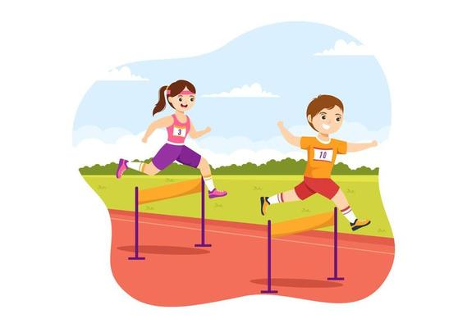
Writing
P.E.
This term, we are learning about instructional writing. We will learn how to write instructions in the form of recipes, guides and manuals. This will link to our topic of sustainability and healthy eating.
We will then move onto discursive writing, where we will learn the difference between fact and opinion, as well as how to write persuasively and argumentatively.
Currently P.E. lessons will take place on a Monday afternoon and Friday afternoon. We sometimes have an extra session on Tuesdays before lunch. On Fridays, Mrs Leggatt will come in to teach us P.E. We will also have swimming every Monday morning.
Some sessions will be devoted to gross-motor skills, balance and general fitness. This will aid development across a wide range of sports and activities. The other sessions will be based on developing sports specific skills, such as rackets and ball control with feet and hands.
We will be learning about racquet sports to start off the term, including both badminton and tennis. We will then spend the end of the term focusing on athletics in preparation for sports day.
Spanish
Throughout the year, we have expanded our knowledge of Spanish vocabulary by engaging with talking, listening, reading and writing activities.
Some of the topics we have covered include:
Greetings
All about me
Numbers
Days and months
Colours
Animals
Hobbies
This term we will revise what we have learned so far, as well as covering birthdays, classroom instructions, food and clothes.
Food and Health
We will be learning about how to take care of our health this term. We will learn about eating a healthy and balanced diet, as well as how to prepare healthy snacks.
We will also discuss how cleanliness, hygiene and safety can affect our health and well-being and apply this knowledge into our everyday routines and self-care.
Swimming
We have the fantastic opportunity to attend weekly swimming lessons this term. The swimming lessons take place at Abbeyhill Primary School every Monday from 10am to 12pm. There will be 6 sessions in total.
The children need to bring swimwear and a towel, preferably in a separate swim bag or plastic bag, so that they don’t have to carry their whole school bag with them. They will be able to eat their snack while at swimming. Every child requires a swimming cap and goggles to take part in swimming lessons. It is great if they can bring their own but we have spares for anyone who doesn’t have it with them.
Questions…?
Should you have any questions or concerns please come and contact me.
(A quick chat at the end of the school day if it is a small issue or e-mail the school to arrange a meeting for a more serious conversation - admin@royalmile.edin.sch.uk.)
Kind regards,
Miss McGivern

