Slide 1
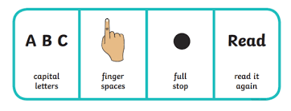
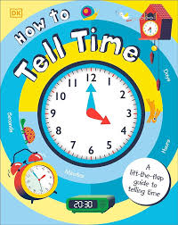
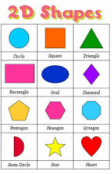
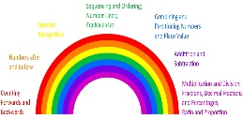
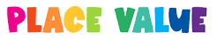
Primary 2’s term ahead
This term we will be learning…
Literacy
Writing
Talking and listening – We are excited to hear about more class pet ‘Sparkle’s news’ and are looking forward to finding out more about adventures each learner gets up to. We are working hard on when and how to listen and talk as well as how much to say, asking questions and how to respond with respect.
Spelling – We are revising all single letter sounds and are gaining confidence in reading and writing CVC words using all letters of the alphabet. We will revise and learn more vowel diagraphs- two or three letters representing one sound, e.g. ai, igh, ee, oo. We will also continue to read and write red, or tricky words this term e.g. any, some, be. Reading - Pupils have a reading book which is reviewed each week. We will learn encourage reading with expression as well as using. Handwriting – we will continue to develop understanding of letters that sit on the line (grass), letters that are tall (sky) and letters that drop below the line (earth). We will continue to focus on the differences between the letters like b and d.
This term we will continue to increase the number of common and tricky words we know. We will practise these by using flashcards, identifying them in our reading or library books and writing them using the look, say, cover, write and check method.
We will use these words in short dictated sentences. We will create our own imaginary stories using pictures, recording our voice and writing simple sentences.
Mathematics
Beyond number - We will be looking at topics of time and shape.
We will learn:
To explore 2D shapes and 3D objects
To identify, name and describe their features using appropriate vocabulary.
Time
We will learn:
To link routines and events in my world with times and seasons.
To order months of the year into order and seasons.
To know different parts of my day and what happens at certain times.
To understand we use clocks to tell the time and start to be able to recognise o clock.
Numeracy
Mental Agility Rainbow - This term we will be focussing on Place Value and partitioning. This will include focusing on how numbers are constructed, the importance of zero and the link between a digit, its place and value. Making tens and ones using physical materials such as arrow cards, number tokens, Dienes blocks, arrays, ten frames to represent numbers and writing numerals and calculations such as 10 + 7 = 17

Slide 2


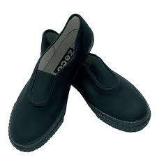

RME
Building Resilience
Our module this term is called Expect the unexpected. Through this we will learn:
That change is a normal part of life
That it is ok not to be ok, we all have times where things are difficult
Ways to look after our own mental health and how we can help ourselves feel better.
We will share our learning in .
assemblies and there will be a home
task to join in with as well.
HWB
This term we are learning about Islam.
We will explore Islamic stories and describe some key beliefs. We have several Muslim learners in the class and are hoping to draw on their experiences and share customs and celebrations. The aim is for all learners to talk about their own beliefs or express them in other ways. We will explore some places and investigate artefacts. We are excited to visit the Central Mosque on Thursday, 12th September.
Supporting at Home
Practising reading at home is key to imbedding literacy. Regular practice of red or tricky words to develop fluency and recognition.
Ask your child questions while reading such as drawing on own experiences, what will happen next in the story and if they liked the story and why.
The blog is updated regularly with day-to-day photos and information of what we have been up to.
Practise independence with getting changed including learning how to tie laces.
Talk with your child about their lunch choices.
Please complete two
games weekly
Organisation
Always pack a coat, even if it looks sunny.
Weather appropriate outdoor shoes which can be taken off/put on independently.
Pupils should have a pair of indoor shoes at school e.g. plimsoles.
Check your child’s bag for letters every day.
Snack is 1 small, healthy item that can be eaten quickly e.g. a banana.
A refillable water bottle.
Please do not bring toys from home to school.
Writing names on jumpers, coats and PE kits helps us return property to the rightful owner.
Please do not wear jewellery to school as this is a health and safety issue, thank you.
Personal Achievement
A star of the week is chosen by the Primary 2 staff team for outstanding effort and will receive a certificate. We have also begun a star writing wall with examples of wonderful pieces of writing that have been produced alongside those which are examples of superb effort. Pupils receive verbal praise throughout the day for both effort and outcome, as well as reinforcing positive behaviours such as kindness and respect. Pupils are encouraged to share achievements from outside school.
Communication
Please feel free to see Ms Brunner anytime after school or arrange a more private chat in person or over the phone.
We would love you to leave a comment on our blog page.
Warm wishes, The Primary 2 Team.

