Slide 1



Welcome to P2.
In this final term of Primary 2 we will be learning…
In Literacy we will continue to work on Read Write Inc. The phonics programme provides a systematic approach to teaching spelling and reading. The children will continue to develop fluency, blending, decoding, knowledge of tricky words as well as building vocabulary and comprehension. In addition we will continue to use the Wordsmith programme for reading comprehension, speaking and listening as well as grammar and writing.
Listening and Talking
We will continue to :-
Build core skills
Paired work- talk partners
Collaborative task and group work
Ask and answer questions
Presentation skills
Literacy
Numeracy
We will continue to use SEAL (Stages of Early Arithmetical Learning) to promote understanding of addition and subtraction, number patterns, sequencing, grouping and sharing. It allows children to understand and experience number at an appropriate pace and level. We will continue using our daily mental rainbow agility with a focus this term on combining and partitioning.
In Primary 2 we:-
Continue to develop more independent learning
Provide opportunity for child-led purposeful play
Increase responsibilities and independence
Focus on developing positive peer relationships
Health and Wellbeing
This term we continue to build resilience as a whole school focus. We will also focus on how we are all unique, learning to recognise our individual skills and abilities as well as those of others. We will also explore how friendship, caring, sharing, fairness equality and love are important in building positive relationships.
Health & Wellbeing

Slide 2


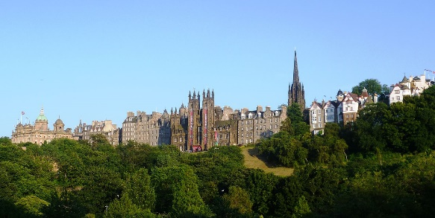

PE
Classes will have 2-3 P.E. sessions per week totalling at least 2 hours. This term in PE we will spend a longer time developing our gross motor skills through gymnastics. We will be aiming to further our body awareness and potentially learn some new skills, such as a backwards roll, headstand or a cast off from a bar. These skills, and how they will be practised, will be determined on an induvial basis. Safety will paramount when they are being performed. As well as these whole body movements we will try to keep improving our ball skills (e.g., throwing, kicking and catching) and rackets technique (e.g., timing the ball and hitting it at varying speeds).
The remaining session will focus on gross-motor skills, balance and general fitness / health.
Progress across P.E. is tracked and monitored individually.
Each pupil must have a P.E. kit.
We do not have school branded kit. Any change of t-shirt and shorts / tracksuit bottoms / leggings is suitable. The only requirement is that no football tops are worn. We would appreciate parents / carers support in this.
Outdoor Learning
P.E.
R.M.E.
For RME, we will continue to explore stories from world religions, developing an awareness of the ways in which followers of world religions celebrate different times of year and relate this to the children’s life and community.
Art
Our focus for ART this term will be linked to our old town topic. We will have the opportunity to choose and explore a range of media and technologies to create images and objects
Topic
We will be learning about the Old Town as our topic. We will use evidence to recreate it’s story and compare aspects of people’s daily lives in the past with our own.
How Can we Help at Home?
Use the internet or visit the library to research our topic (or any other area that is of interest).
Share a book together regularly and talk about what you have read.
Discuss age appropriate numeracy topics such as the numbers on buses, counting toys, etc.
Encourage your child to be as independent as possible ie tying shoe laces and being able to zip up a coat.
Music
We will have a specialist music visitor who will be taking part in singing sessions with the children. The children will explore playing with sound, rhythm, pitch and dynamics.
Should you have any questions or concerns please come and contact me.
(A quick chat at the end of the School day if it is a small issue, or e-mail the school to arrange a meeting for a more formal conversation ) admin@royalmile.edin.sch.uk.)
Kind regards,
Mrs Gladstone, Mr Dawes-Salazar and Mr Madine
Questions…?
Should you have any questions or concerns please come and contact me.
(A quick chat at the end of the School day if it is a small issue, or e-mail the school to arrange a meeting for a more serious conversation - admin@royalmile.edin.sch.uk.)
Kind regards,
Mr. Dominguez

