Slide 1

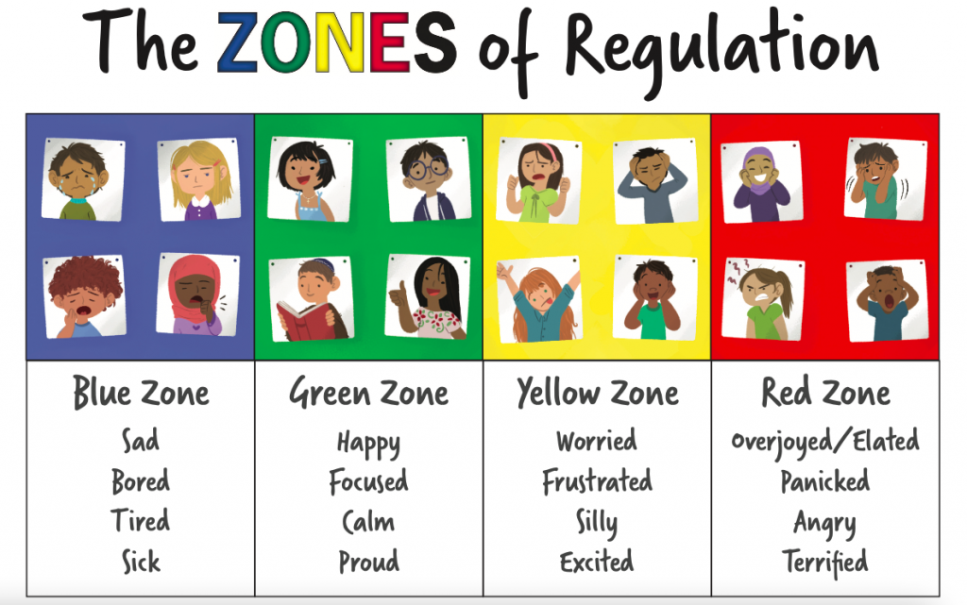
Welcome to ESB2!
This term in ESB2 we will be learning…….
Literacy
Maths
Read, Write, Inc: We use the Read, Write, Inc. literacy programme as our key literacy resource. The programme encompasses reading, writing and spelling and allows all children opportunities for success.
Handwriting and letter formation:
Children will be encouraged to practice their fine motor and letter formation skills. We will use a range of sensory approaches to make this engaging and accessible for all.
Opportunities for Writing and Text Creation:
Children will have the opportunity to create a range of texts across varied genre including scripts, fact sheets and imaginative stories.
Mental Agility: To improve our mental agility we will complete a range of short, hands-on activities; building confidence with number and in turn improving the accuracy of calculations. Our focuses will be number recognition and sequencing and ordering, numbering and equivalences.
Four Operations:
This term in ESB2 we will be focusing on using the four operations of addition, subtraction, multiplication and division. We will use a range of strategies and concrete materials to make all in the class to have success.
Time:
We will be looking at timetables and schedules, using these to complete time calculations. We will also estimate times events and select the appropriate unit of time. To challenge we will also look at speed, distance, time calculations.
Speech and Language Therapy: ESB 1&2 are supported by our Speech Therapist, Jayne, who is in school on Wednesdays. Jayne may provide activities to support your child throughout the week.
Health & Wellbeing
SCERTS
Zones of Regulation:
We use the Zones of Regulation as an “emotions check-in” each morning. The children are learning to discuss how they are feeling, and are becoming more independent in using strategies that help regulate their emotions e.g. bouncing on a ball, having time alone, lying under a weighted blanket, using ear defenders.
The Human Body and Healthy Choices:
We will explore how the human body works and how we can keep ourselves healthy. We will also look at food packaging and use this to plan healthy meals and snacks.
Each child in the ESB now has a completed SCERTS assessment with specific targets to improve their communication and emotional regulation skills. We will use a combination of specific class based activities and less formal interactions to enable each child to progress towards their individual targets.

Slide 2
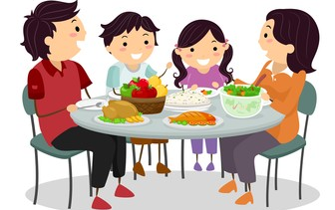
Cross-Curricular Learning
Baking
This term we will be working on a range of cross-curricular topics. Children will be included in the planning of these topics, allowing them to research and develop ideas according to their own interests. Topics covered this term include:
Scotland’s History and Heritage
We will explore different elements of Scotland’s history in line with each child’s individual interests. We will find information using a range of sources including online, books and a visit to a museum.
Hinduism and the Festival of Holi
We will look at Hindu beliefs and traditions, and how these beliefs are similar and different to other world religions. We will have a focus on the festival of Holi (8th March), looking at how it is celebrated, what the significance of the festival is and completing a range of sensory activities based on colour and texture.
Puppet Theatre
We will create our own puppet theatres, characters and short performances. This interdisciplinary topic cover outcomes across literacy, technologies and art. Children will be able to make their own theatres, draw and paint/colour their backgrounds, make sock/spoon puppets and write their own story and script. We will film the performances to share.
On Thursday afternoons Mrs D will lead baking and cooking with ESB2. We will use this as an opportunity to sample a range of foods, including foods from other cultures and parts of the world. We will also practice the life skill of planning, shopping for, preparing and eating a meal as a class. Sitting around a table with a freshly made meal will provide the children the opportunity to build relationships and take pride in what they have made.
Art
On Wednesday afternoons the class will take part in a range of art activities. These may be based on the current class topic or discrete art lessons focusing on a specific technique or artist.
PE and Walk a Mile
Every day children will take part in walk a mile. This gives the children the opportunity to take time out of the classroom and in fresh air. When regulated children will be offered the opportunity to join their mainstream class in PE lessons.
Things to remember
Mrs D’Ambrosio (Mrs D) supports our learning everyday.
Mrs Mantegani (Mrs M.) supports in class on Mondays and Tuesdays.
Ms. Sola will be covering non-class contact time and management time on Tuesday and alternate Wednesdays.
Please ensure your child has warm, waterproof clothing with them. We take our learning outside as often as we can and the weather is changeable.
Questions…?
Should you have any worries, questions or concerns, please feel free to, email us at esb@royalmile.edin.sch.uk or phone the school office on 0131 556 3347
Kind regards,
Mr McPheely

