Slide 1
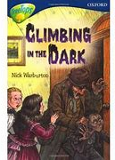
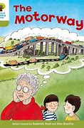

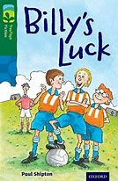



Welcome to Term 2 in Primary 6!
In the second term we will be learning…
Literacy
Numeracy & Maths
We are starting this term in our reading ability groups. We are going to start taking up different roles of
being READING DETECTIVES. During each reading session we will investigate different skills such as predicting, clarifying, questioning and summarising. After each task learners will evaluate themselves or each other against given criteria and decide on effort and success.
For Numeracy we will start the term focusing on working with the four operations using a variety of strategies to solve calculations.
Some of our aims are to practise partitioning to help in calculations and using our knowledge of adding and subtracting 10 to add and subtract numbers that are near 10. Another strategy we will gain confidence in is bridging to help with calculations and aim to use more than one strategy for solving calculations as well as checking calculations using different strategies. We will use informal jottings and resources as required and formal written methods to work
out calculations.
.
Next we will be exploring fantasy fiction. We will read the interactive eBook of Spiderwick Chronicles, asking questions and developing understanding of inference. We will use drama to explore characters and suspense and develop editing and proof-reading skills. Next we will plan, edit and write a new episode of the fantasy story we have studied.
We will also explore angles and measure and learn how to apply these concepts to everyday situations and word problems.
Health & Wellbeing
This term we are going to engage with the RSHP (Relationships, sexual health and parenthood) resources and focus on learning how positive relationships enhance emotional wellbeing and know who or where to go to for support if needed.
Furthermore we are going to discuss how bodies change with puberty and the impact on feelings and behaviour as well as the importance of personal hygiene.
Next we will explore what makes us unique and the idea of diversity by considering stereotypes and
gender-biased
expectations.
Islam
Primary 6 are very keen to find out more about ISLAM. We are going to explore what Muslims believe in by focusing in the 5 pillars of Islam, their holy book and place of worship.
Primary 6 will visit the central mosque on Thursday, 9th February.
We will learn all about the Islamic creation story, Ramadan, Eid ul-Fitr and Eis ul-Adha.
Primary 6 are excited to find out more about Hajj and Ka’bah.
We would love learners and their families to contribute by sharing their faith with our class!

Slide 2

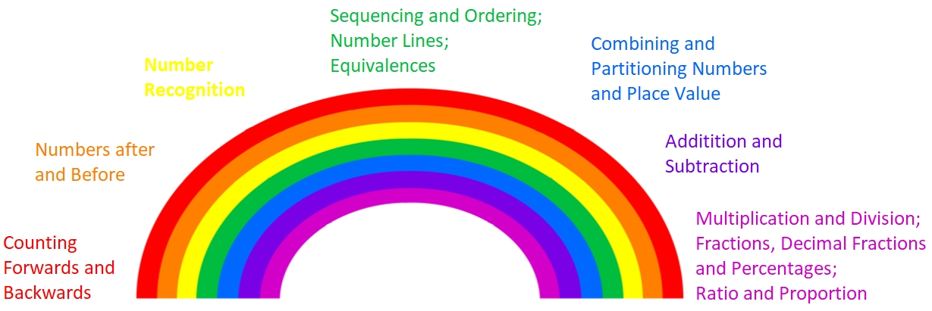


Science/ Drama
We are learning about space and the universe as we practice research techniques and collaborative learning.
During drama, we will explore character development and hot seat techniques.
P.E.
P.E. sessions per week are totalling to at least 2 hours. One or two lessons will be developing sports specific skills, such as racket and ball control with feet and hands. These areas will change regularly to give pupils the repetition needed to increase their competence and experience. Rules of specific games will also be included as well as skills transferable to a range of sports and activities.
The remaining session will focus on gross-motor skills, balance and general fitness/health. Progress across P.E. is tracked and monitored individually.
In addition to our normal P.E. routine we will also be taking time to learn and practise Scottish Country Dancing in preparation for our Scots Week. Dances that classes may learn will be the Canadian Barn Dance and Strip the Willow.
Writing
We will learn how to create a quality piece of imaginative writing, exploring character, setting and plot and figurative language.
Later in the term, we will practice our persuasive and discursive writing.
Interdisciplinary
Annual Art Exhibition 2023 – All about SPRING!
This term we participate in our school-wide expressive arts project. As a class, we shall reflect on our unique blend of experiences, and interpretations of this season and what it stands for. The Art Exhibition will take place in April! We look forward to sharing our creativity with you!
Modern Language - German
In the second term we are learning how to describe the weather, name animals and family members. Next Primary 6 will focus on body parts and the names of clothing.
Mental Agility
P6 Blog
We will start this term with the yellow section of our Mental Agility rainbow focusing on – Number recognition. Our activities will include recognising and writing numbers to 1 million in numerals and words as well as decimal tenths and fractional steps. Additionally we will focus on negative numbers as well as coins and notes.
We also regularly post important information and feedback from our learning on the P6 blog which can be found on the school website, Primary 6 Blog – Royal Mile Primary School
Questions…?
Things to remember
Should you have any worries, questions or concerns, please feel free to speak with us
(at the end of the School day is
usually the best time)
Kind regards,
Ms Brunner
Mrs Speedie teaches P6 every Wednesday.
P.E. kit, named water bottle and snack in school every day please.
Please bring indoor shoes and suitable clothing for outdoor learning.

