Slide 1
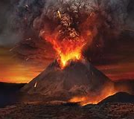
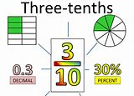




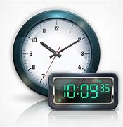

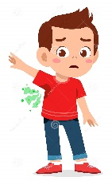
Welcome to P7!
In the last term in Primary 7 we will be learning…….
Literacy
Maths
We will conclude our imaginary mission back in time to warn the people of Pompeii about the volcanic eruption. We will read a Non-fiction e-book, locating key information in the text and creating an action plan.
We are continuing to work on
identifying, creating and
calculating, including improper and mixed, fractions. We will focus on comparing and ordering fractions, including working out the simplest form, and converting them into a decimal fraction as well as relating percentage to fractions and decimals.
Next we will gain confidence in telling the time on 24 hour digital and analogue clocks. We will explore how people plan their lives using times and dates and the different time calculations people carry out to help them plan their lives. Some learners may progress to investigating how people plan and make decisions about their time and how these are recorded.
Next we are returning to our reading ability groups. We will considering impact od author’s use of language, justifying inferences with evidence and exploring different accounts of the same event and discuss viewpoints.
Health & Wellbeing
We are going to focus on relationships, sexual health and parenthood (RSHP) education. Here are some of the things we are planning to cover:
Feelings and puberty
Personal hygiene
Stereotypes and equality
Getting creative with . classical music
Ten Pieces is an exciting initiative aiming to open up the world of classical music to a new generation of children and inspire them to develop their own creative responses to pieces of music using a variety of art forms
James Gillespies (Cluster) Sports day
We are delighted to be able to spend a Cluster Sports day (learners transitioning to James Gillespies High School only!) at Meggetland on Monday, 13th June to take part in many exciting activities with other children moving up to the same high school.

Slide 2

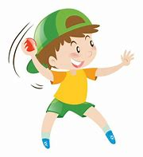





Maths, money and finance
P.E. lessons will take place each Monday and Tuesday
P.E.
This term will be discuss how to manage money, compare costs from different retailers, and determine what we can afford to buy. We will focus on understanding the costs, benefits and risks of using bank cards to purchase goods or obtain cash and realise that budgeting is important.
We will be focusing on fitness,
athletics and summer games this term.
Writing, VCOP and grammar
We will be working on our transition to High School writing task. We will write an imaginative story and focus on setting, plot and characterisation.
Eco
We will explore non-renewable energy sources and how they are used in Scotland today and create an informed view on the implications for their future use.
We will focus on how to live in a more sustainable, eco-friendly way.
Home Learning
All children are expected to consolidate their learning at home. Homework will be found on P7 TEAMS weekly. Please upload your work regularly.
Modern Languages
Please remember to check out our P7 blog
and see our day to day
learning.
www.royalmileprimary.com/category/ primary-7-blog
Mrs Speedie will be teaching the following topics this term: ‘Around the School’ and ‘Hobbies and Sports’.
Things to remember
Questions…?
Mrs supports our learning
Tuesdays-Thursdays.
Mrs Speedie teaches P7 every Wednesday.
P.E. kit required every Monday and Tuesday.
Named water bottle and snack in school every
day please.
Please bring indoor shoes.
Should you have any worries, questions or concerns, please feel to contact us.
ALWAYS
Kind regards
MsBrunner

